Slide 1

Sentiment Detection
Group 8
Presenter:
Zihao OU 2430034051 u430034051@mail.uic.edu.cn Yuxuan TONG 2430034064 u430034064@mail.uic.edu.cn Yinuo PANG 2430034053 u430034053@mail.uic.edu.cn Yiqi LUO 2430034046 u430034046@mail.uic.edu.cn

Slide 2
Data Exploration
& Data Visualization
01
Project Overview
02
03
User Interface
04
Project Conclusion

Slide 3

Background
User-Generated Content (UGC) ↑
Demand → (Insight → Public opinion & Evolution of public sentiment)
Overview
Purpose
Identify key words for each sentiment.
Predict sentiments using language.

Slide 4
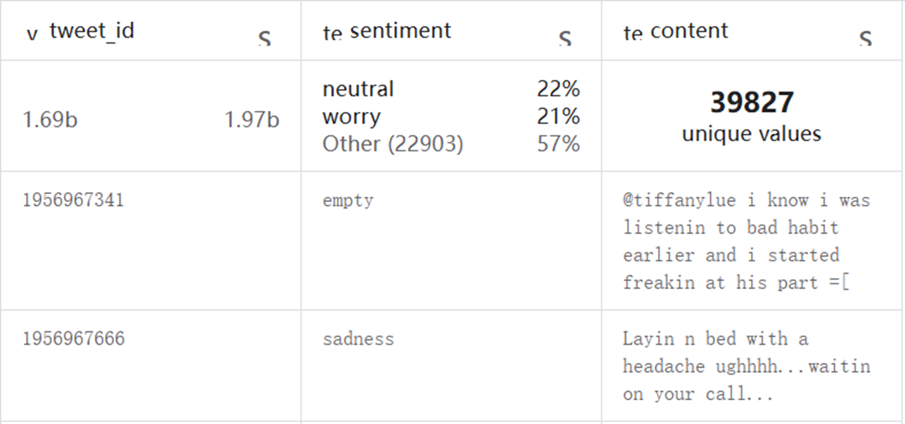
Overview
Content: 39,827 sentiment-labeled text samples.
Columns: "tweet_id" , "sentiment" , "content"
Quality of data: Dirty
Numbers, punctuation marks, user mentions, and non-semantic words found

Slide 5
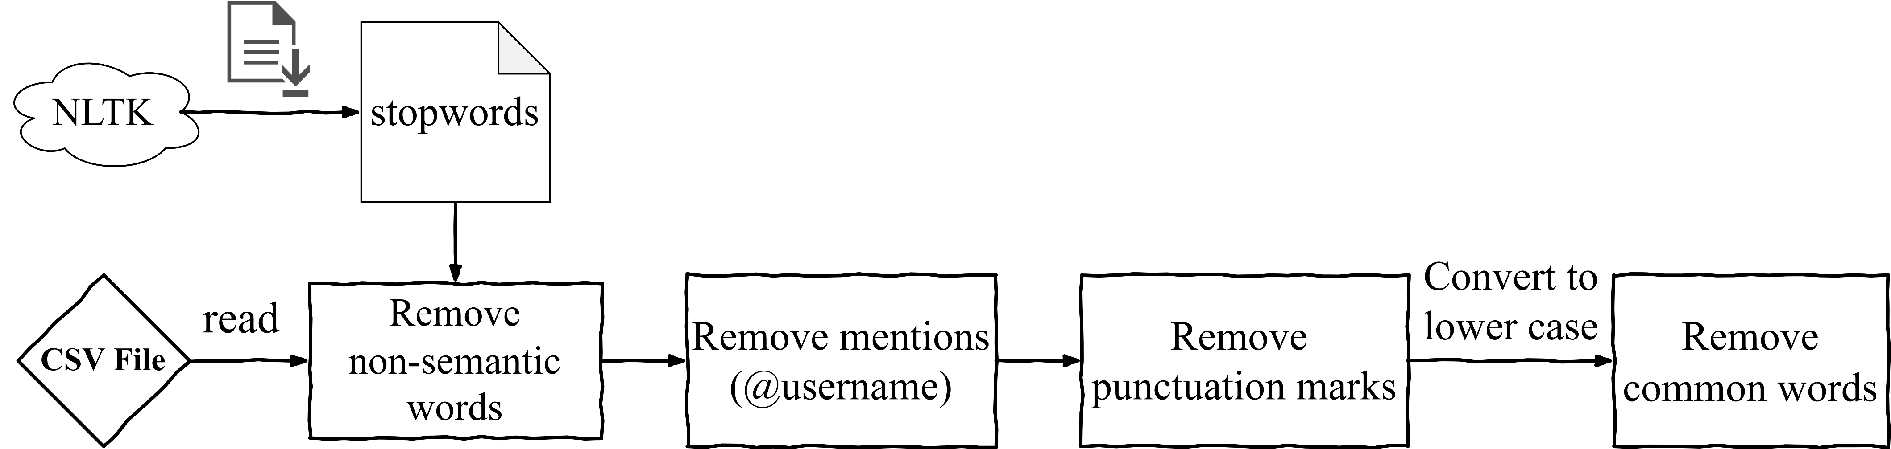
Data Exploration
Data Preparation

Slide 6
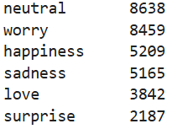
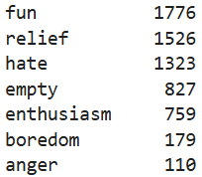
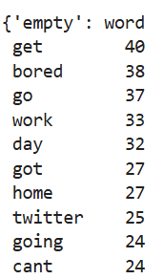
Data Exploration
Split cleaned contents into words.
Create a pandas DataFrame with words and sentiments.
Get sentiment types.
Identify the 10 most common words for each sentiment.

Slide 7
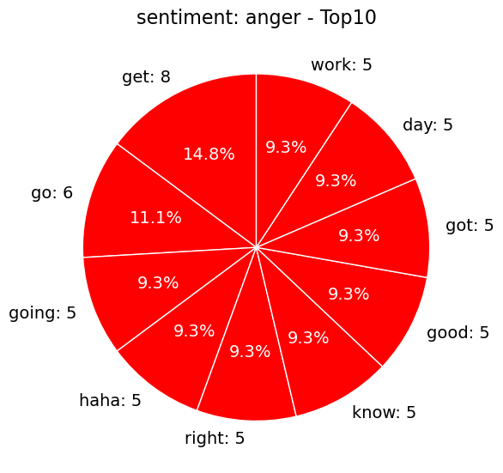
Data Visualization: Pie Chart
Purpose
Illustration of proportions & counts
Implementation
Pie charts
Sentiment-matching colors

Slide 8
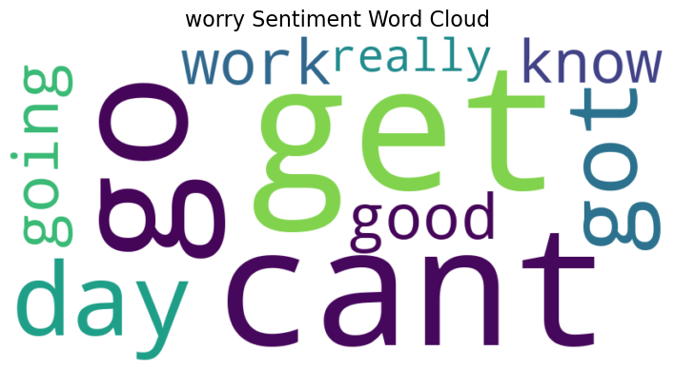
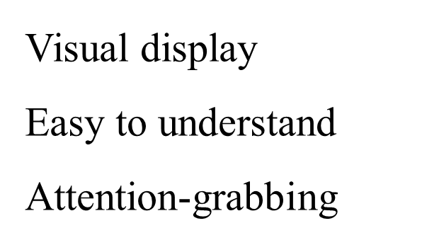
Data Visualization: Word Cloud
Word size Frequency
}
More illustrative
the top 10 words for each sentiment

Slide 9
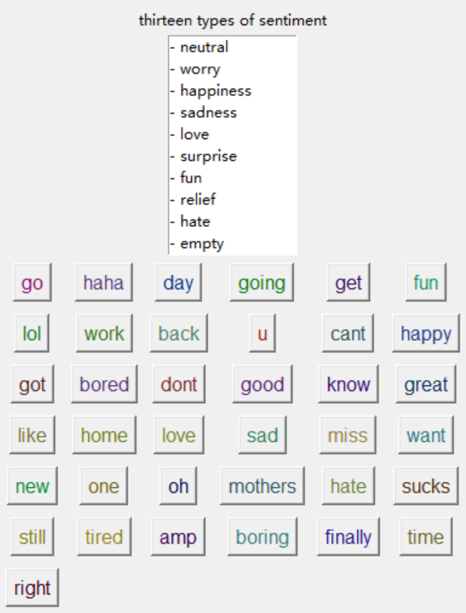
User Interface
List box of all sentiments
Bottons of all top words

Slide 10
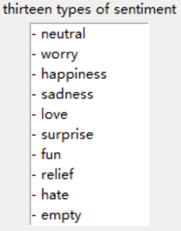
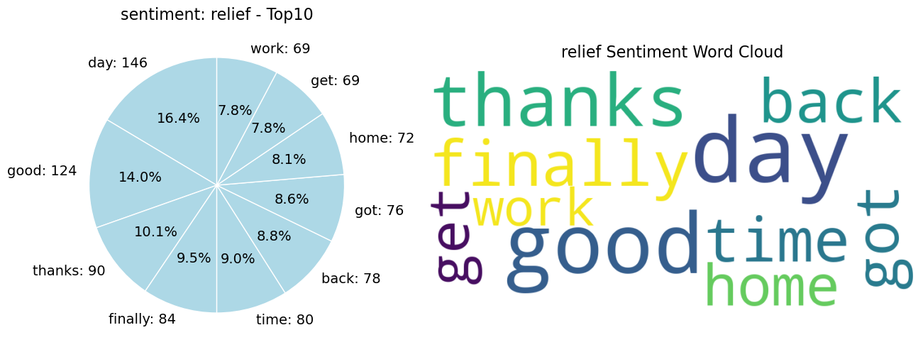
User Interface
Sentiment keywords
List of 13 sentiments
E.g.
Top 10 Keywords
Click one

Slide 11

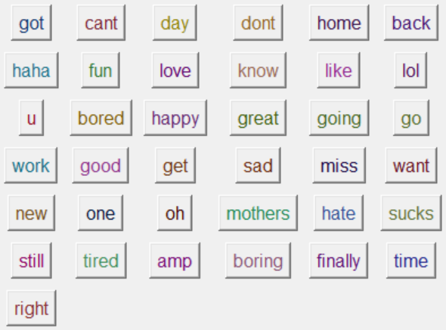
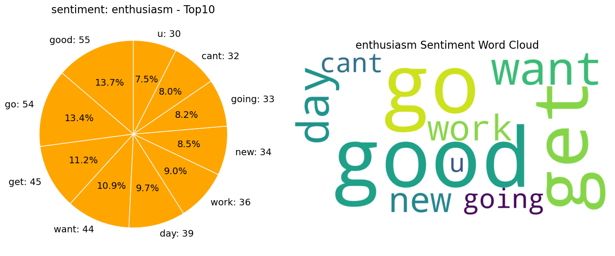
User Interface
Word matches sentiment
E.g.
click
All words
Enthusiasm

Slide 12
Conclusion
Result
Each sentiment has its own characteristic wording
Target Audience
Social media companies
Government
Psychology researchers
Researchers of sentiment prediction models based on natural language processing (NLP)

Slide 13
Conclusion
Future Improvements
Improve the user interface
Use diverse visualization tools (e.g. interactive charts and heatmaps)
Strengthen data processing
Further filter out words with ambiguous emotional tendencies (e.g. 'go', 'get' and 'work').
Learn more knowledge to building sentiment prediction models based on any natural language.

Slide 14
Thank you

Slide 15
Demonstration
Time

